Slide 1
Cryptography and Network Security Lab
Lab-4
Dr. Sunil Gupta
Professor- SoCS, UPES

Slide 2
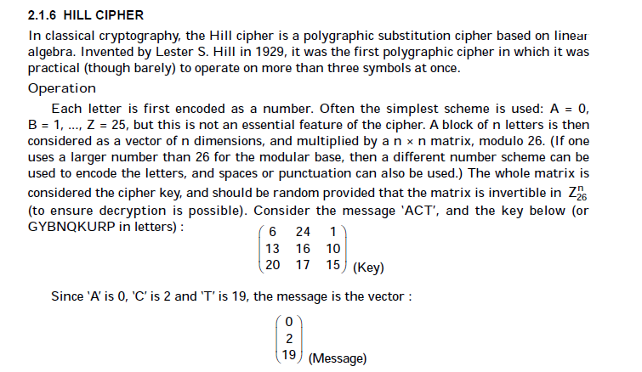

Slide 3
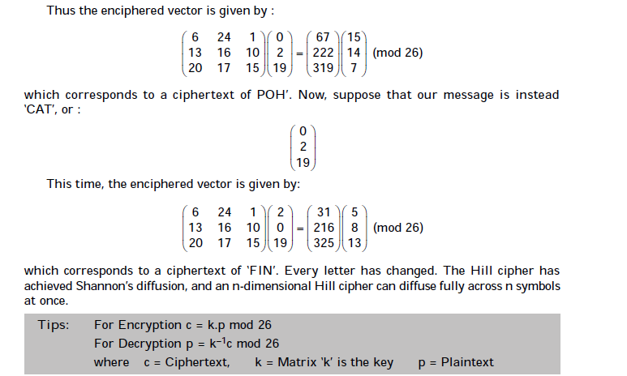

Slide 4
Examples: Hill Cipher
Input : Plaintext: GFG
Key: HILLMAGIC
Output : Ciphertext: SWK

